Slide 1
Divide-and-Conquer Technique: Merge Sort

Slide 2
Divide-and-Conquer
Divide-and-Conquer is a general algorithm design paradigm:
Divide the problem into a number of subproblems that are smaller instances of the same problem
Conquer the subproblems by solving them recursively
Combine the solutions to the subproblems into the solution for the original problem
The base case for the recursion are subproblems of constant size
Analysis can be done using recurrence equations

Slide 3
Merge Sort and Quick Sort
Two well-known sorting algorithms adopt this divide-and-conquer strategy
Merge sort
Divide step is trivial – just split the list into two equal parts
Work is carried out in the conquer step by merging two sorted lists

Slide 4
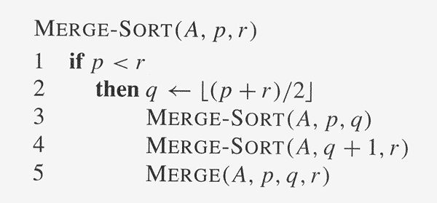
Merge Sort: Algorithm

Slide 5
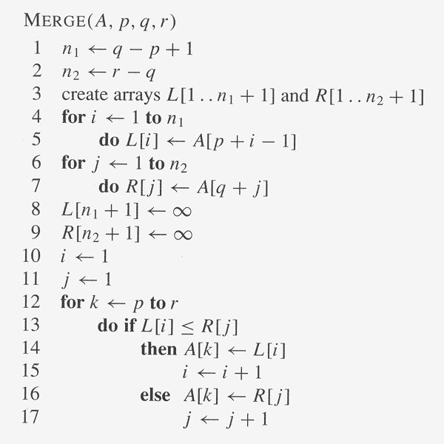
Merge Sort: Algorithm

Slide 6
Execution Example
Partition
7 2 9 4 ⏐ 3 8 6 1 → 1 2 3 4 6 7 8 9
7 2 9 4 → 2 4 7 9
3 8 6 1 → 1 3 8 6
7 2 → 2 7
9 4 → 4 9
3 8 → 3 8
6 1 → 1 6
7 → 7
2 → 2
9 → 9
4 → 4
3 → 3
8 → 8
6 → 6
1 → 1
Merge Sort
6

Slide 7
Execution Example
Recursive call, partition
7 2 9 4 ⏐ 3 8 6 1 → 1 2 3 4 6 7 8 9
7 2 ⏐ 9 4 → 2 4 7 9
3 8 6 1 → 1 3 8 6
7 2 → 2 7
9 4 → 4 9
3 8 → 3 8
6 1 → 1 6
7 → 7
2 → 2
9 → 9
4 → 4
3 → 3
8 → 8
6 → 6
1 → 1
Merge Sort
7

Slide 8
Execution Example
Recursive call, partition
7 2 9 4 ⏐ 3 8 6 1 → 1 2 3 4 6 7 8 9
7 2 ⏐ 9 4 → 2 4 7 9
3 8 6 1 → 1 3 8 6
7 ⏐ 2 → 2 7
9 4 → 4 9
3 8 → 3 8
6 1 → 1 6
7 → 7
2 → 2
9 → 9
4 → 4
3 → 3
8 → 8
6 → 6
1 → 1
Merge Sort
8

Slide 9
Execution Example
Recursive call, base case
7 2 9 4 ⏐ 3 8 6 1 → 1 2 3 4 6 7 8 9
7 2 ⏐ 9 4 → 2 4 7 9
3 8 6 1 → 1 3 8 6
7 ⏐ 2 → 2 7
9 4 → 4 9
3 8 → 3 8
6 1 → 1 6
7 → 7
2 → 2
9 → 9
4 → 4
3 → 3
8 → 8
6 → 6
1 → 1
Merge Sort
9

Slide 10
Execution Example
Recursive call, base case
7 2 9 4 ⏐ 3 8 6 1 → 1 2 3 4 6 7 8 9
7 2 ⏐ 9 4 → 2 4 7 9
3 8 6 1 → 1 3 8 6
7 ⏐ 2 → 2 7
9 4 → 4 9
3 8 → 3 8
6 1 → 1 6
7 → 7
2 → 2
9 → 9
4 → 4
3 → 3
8 → 8
6 → 6
1 → 1
Merge Sort
10

Slide 11
Execution Example
Merge
7 2 9 4 ⏐ 3 8 6 1 → 1 2 3 4 6 7 8 9
7 2 ⏐ 9 4 → 2 4 7 9
3 8 6 1 → 1 3 8 6
7 ⏐ 2 → 2 7
9 4 → 4 9
3 8 → 3 8
6 1 → 1 6
7 → 7
2 → 2
9 → 9
4 → 4
3 → 3
8 → 8
6 → 6
1 → 1
Merge Sort
11

Slide 12
Execution Example
Recursive call, …, base case, merge
7 2 9 4 ⏐ 3 8 6 1 → 1 2 3 4 6 7 8 9
7 2 ⏐ 9 4 → 2 4 7 9
3 8 6 1 → 1 3 8 6
7 ⏐ 2 → 2 7
9 4 → 4 9
3 8 → 3 8
6 1 → 1 6
7 → 7
2 → 2
9 → 9
4 → 4
3 → 3
8 → 8
6 → 6
1 → 1
Merge Sort
12

Slide 13
Execution Example
Merge
7 2 9 4 ⏐ 3 8 6 1 → 1 2 3 4 6 7 8 9
7 2 ⏐ 9 4 → 2 4 7 9
3 8 6 1 → 1 3 8 6
7 ⏐ 2 → 2 7
9 4 → 4 9
3 8 → 3 8
6 1 → 1 6
7 → 7
2 → 2
9 → 9
4 → 4
3 → 3
8 → 8
6 → 6
1 → 1
Merge Sort
13

Slide 14
Execution Example
Recursive call, …, merge, merge
7 2 9 4 ⏐ 3 8 6 1 → 1 2 3 4 6 7 8 9
7 2 ⏐ 9 4 → 2 4 7 9
3 8 6 1 → 1 3 6 8
7 ⏐ 2 → 2 7
9 4 → 4 9
3 8 → 3 8
6 1 → 1 6
7 → 7
2 → 2
9 → 9
4 → 4
3 → 3
8 → 8
6 → 6
1 → 1
Merge Sort
14

Slide 15
Execution Example
Merge
7 2 9 4 ⏐ 3 8 6 1 → 1 2 3 4 6 7 8 9
7 2 ⏐ 9 4 → 2 4 7 9
3 8 6 1 → 1 3 6 8
7 ⏐ 2 → 2 7
9 4 → 4 9
3 8 → 3 8
6 1 → 1 6
7 → 7
2 → 2
9 → 9
4 → 4
3 → 3
8 → 8
6 → 6
1 → 1
Merge Sort
15

